Slide 1

Introduction to renewable energy trends
Georgios Avgerinopoulos
gav@kth.se
Introductory lecture – Energy commodities and technologies
This work by OpTIMUS.community is licensed under the Creative Commons Attribution 4.0 International License. To view a copy of this license, visit http://creativecommons.org/licenses/by/4.0/.

Slide 2
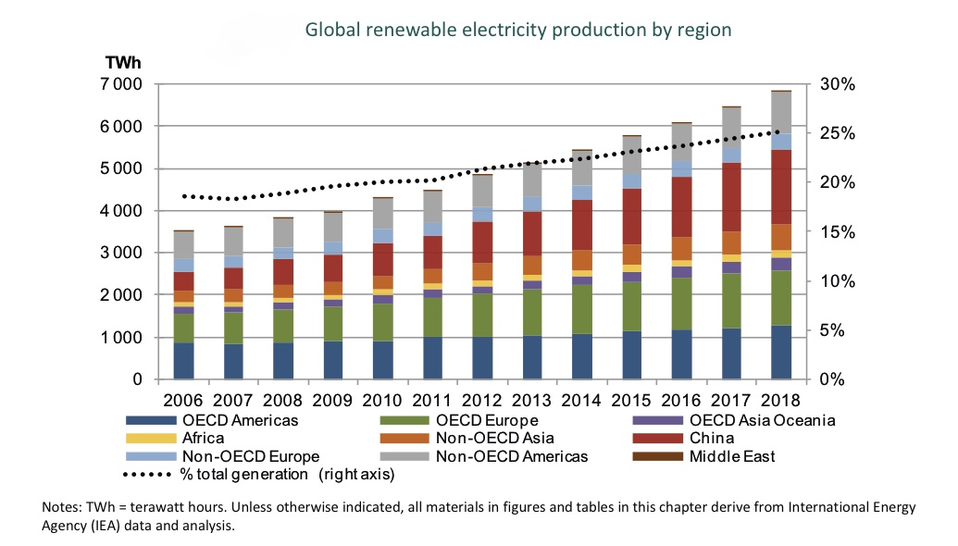
Renewable energy in figures

Slide 3
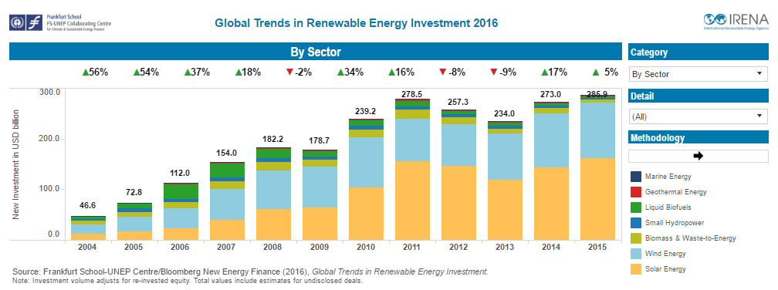
Renewable energy in figures

Slide 4
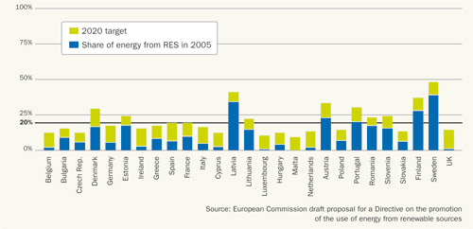
Renewable energy targets

Slide 5
References and reading material
IEA, World Energy Outlook 2016;
European Commission, Joint Research Centre, Energy Technology Reference Indicators (ETRI) 2014. Available at: https://setis.ec.europa.eu/sites/default/files/reports/ETRI-2014.pdf;
IEA, NEA, Projected Costs of Generating Electricity 2015. Available at: https://www.oecd-nea.org/ndd/pubs/2015/7057-proj-costs-electricity-2015.pdf;
IEA-ETSAP, Energy Technology Data Source. Available at: https://iea-etsap.org/index.php/energy-technology-data;

Slide 6
Changelog and attribution
Date | Author | Reviewer | Reviser
2017-09-26 | Georgios Avgerinopoulos | Mark Howells | Georgios Avgerinopoulos
To correctly reference this work, please use the following:
Avgerinopoulos, G., 2017. Introduction to renewable energy trends, OpTIMUS.community. Available at: http://www.osemosys.org/understanding-the-energy-system.html. [Access date]

